Slide 1

HNDIT2417
Mobile Application Development
www.hndit.com
Week 7 ListView

Slide 2
ListView
www.hndit.com

Slide 3
ListView
www.hndit.com
ListView is a view group that displays a list of scrollable items. The list items are automatically inserted to the list using an Adapter that pulls content from a source such as an array or database query and converts each item result into a view that's placed into the list.

Slide 4
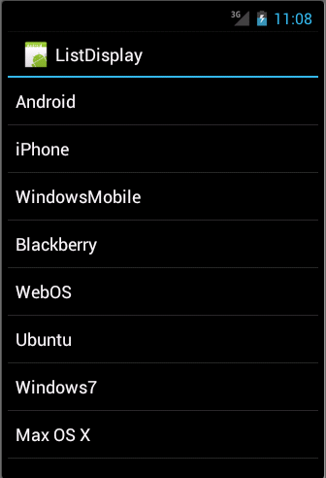
ListView
www.hndit.com

Slide 5
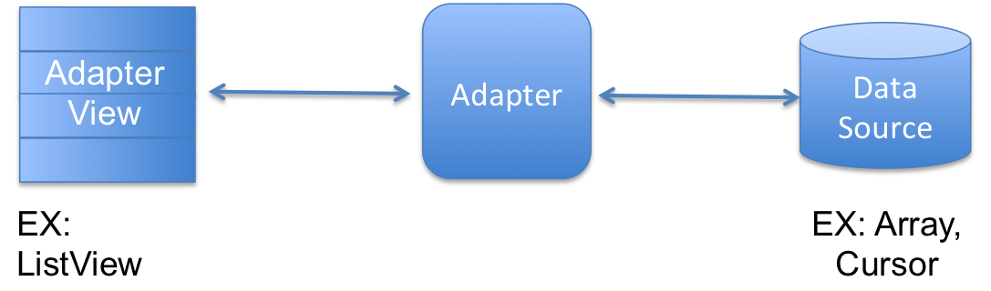
Adapter
www.hndit.com
Android Adapter is a bridge between the View (e.g. ListView) and the underlying data for that view. An adapter manages the data and adapts the data to the individual rows (listItems) of the view.

Slide 6
Adapter
www.hndit.com
Android provides several subclasses of Adapter that are useful for retrieving different kinds of data and building views for an AdapterView ( i.e. ListView or GridView). The common adapters are ArrayAdapter, BaseAdapter, CursorAdapter, SimpleCursorAdapter, SpinnerAdapter and WrapperListAdapter.

Slide 7
ArrayAdapter
www.hndit.com
You can use this adapter when your data source is an array. By default, ArrayAdapter creates a view for each array item by calling toString() on each item and placing the contents in a TextView. Consider you have an array of strings you want to display in a ListView, initialize a new ArrayAdapter using a constructor to specify the layout for each string and the string array

Slide 8
Construction of ArrayAdapter
www.hndit.com
ArrayAdapter adapter = new ArrayAdapter<String>(this,R.layout.ListView,StringArray);
Here are arguments for this constructor −
  First argument this is the application context. Most of the case, keep itthis.
  Second argument will be layout defined in XML file and havingTextView for each string in the array.
  Final argument is an array of strings which will be populated in the text view.

Slide 9
www.hndit.com
Once you have array adapter created, then simply call setAdapter() on your ListView object as follows −
    ListView listView = (ListView) findViewById(R.id.listview);
    listView.setAdapter(adapter);
    You will define your list view under res/layout directory in an XML file.

Slide 10
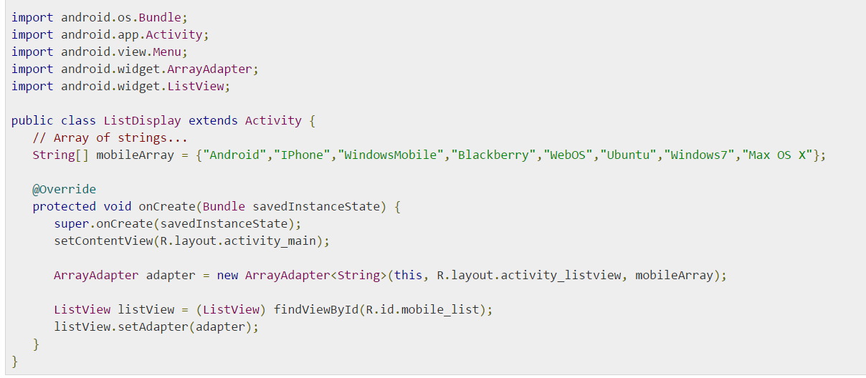
Example- ListDisplay.java
www.hndit.com

Slide 11
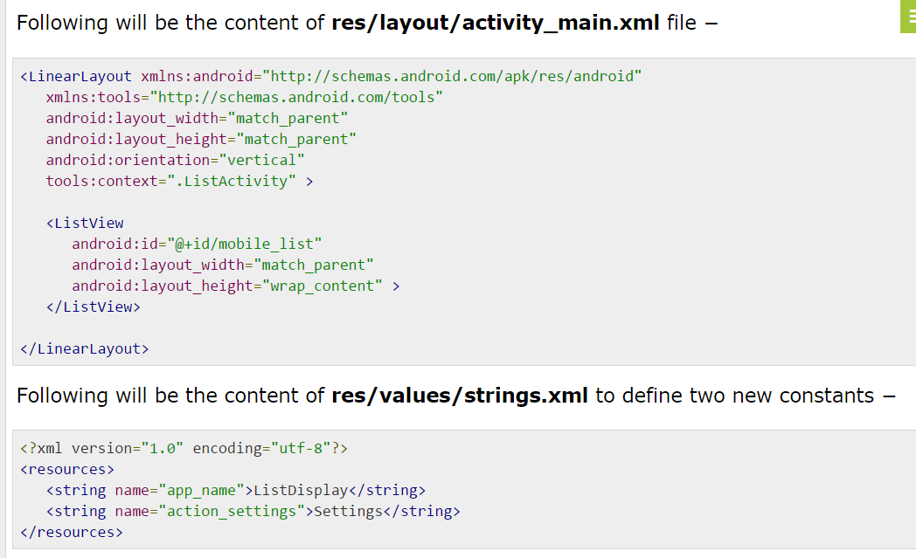
activity_main.xml
www.hndit.com

Slide 12
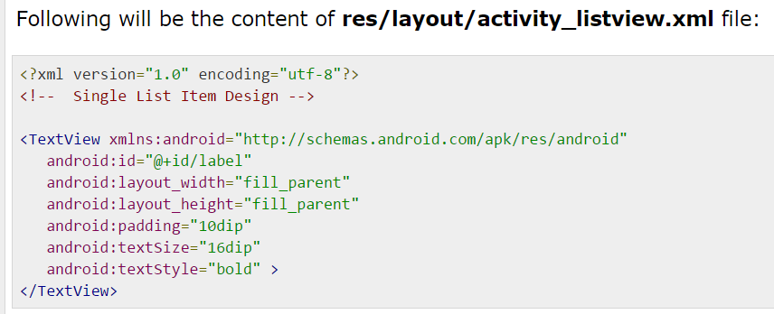
www.hndit.com
Layout for a single row of listView

Slide 13
Output
www.hndit.com

